Slide 1
MPRINT-OKN (Chemical and Materials Informatics)
A platform that enables access to chemical and materials data to accelerate discovery and innovation
mprintokn.org
Notes:
Our mission is to develop a platform that enables access to chemical and materials data to accelerate discory and innovation.
Central to this platform is a network that connects people, data and tools.

Slide 2
MPRINT Platform 1.0
Minimum viable product
MVP
MVS
Minimum viable segment
Notes:
I am going to present to you a minimum viable product of the network platform, a blueprint so to speak.
We will ask for your input on what it will take for you to be part of the minimum viable user segment
The goal is to achieve overlap – so that we can prioritize the next steps.

Slide 3
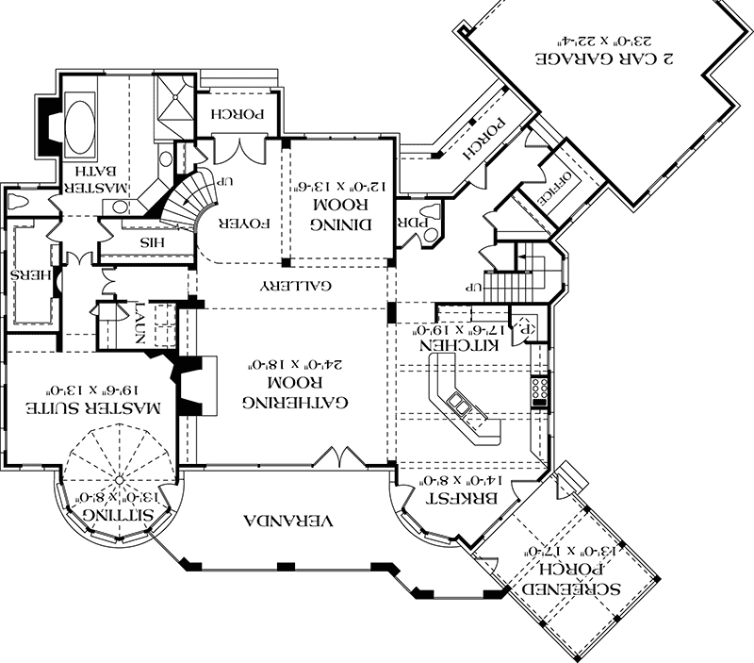
MPRINT Platform 1.0
MPRINT OKN is a user community
Data (Library)
Data workflows (Instruments)
Workflow development (Workshop)
Network
Notes:
Central to the MPRINT platform is the user community.
Linked In of chemistry but powered by data and data instruments.
Key components are:
data in the Library
data workflows called Instruments
workflow development in the Workshop
Now I am going to show you high-fidelity mockups of these components.

Slide 4
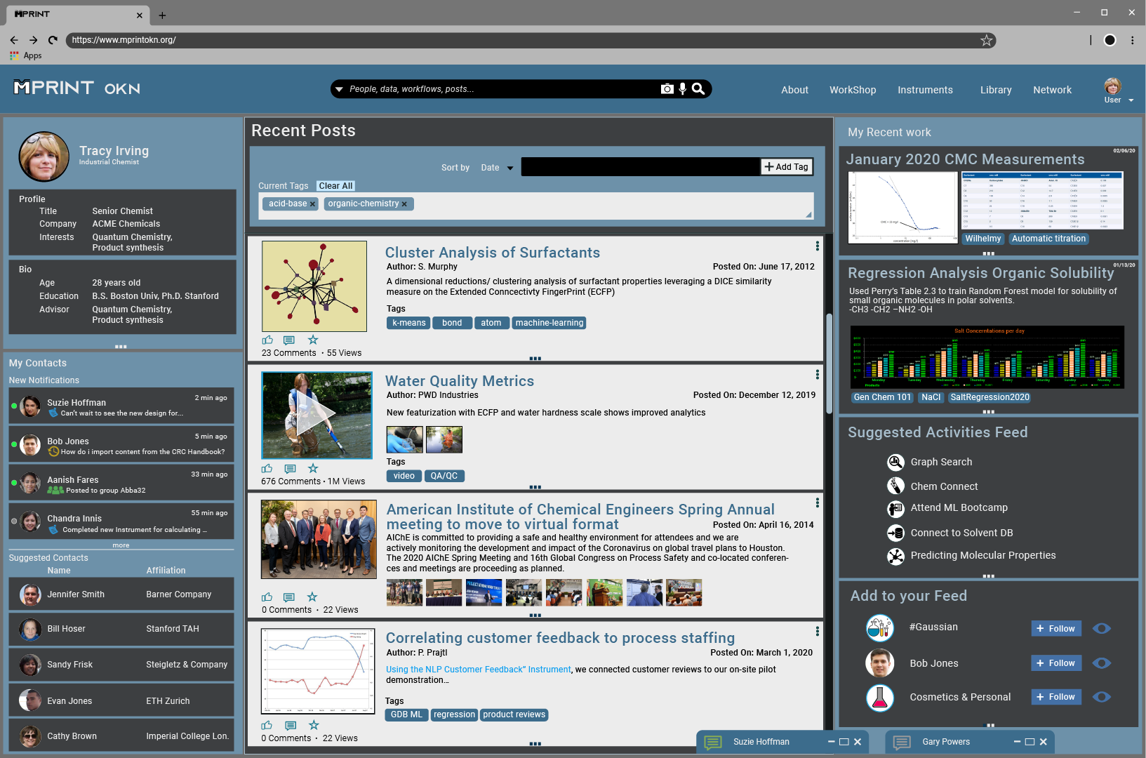
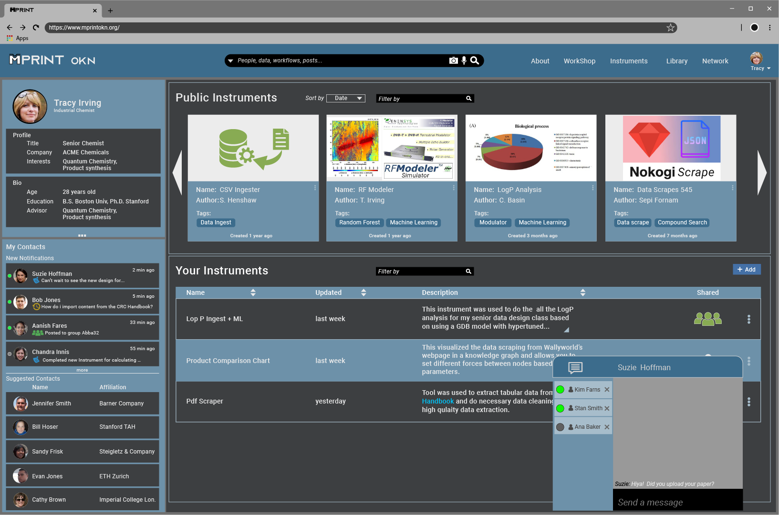
Notes:
User specific homepage
Contacts
Live feed of relevant network posts
Recommended content
CLICK LIBRARY

Slide 5
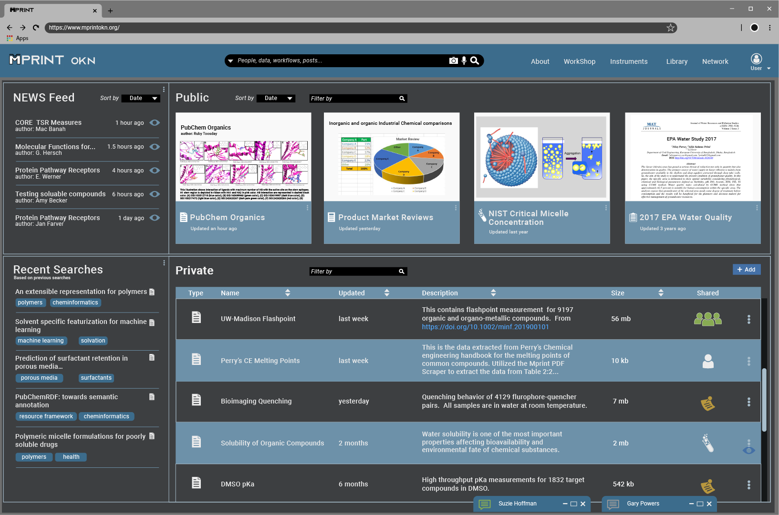
Notes:
LIBRARY
Where data lives
Public section
Private section with user controlled sharing
CLICK INSTRUMENTs

Slide 6
Notes:
INSTRUMENTS
Instruments are packaged data workflows
Public instruments section is like the App store
Also have private instruments, again user can control how those are shared
CLICK WORKSHOP

Slide 7
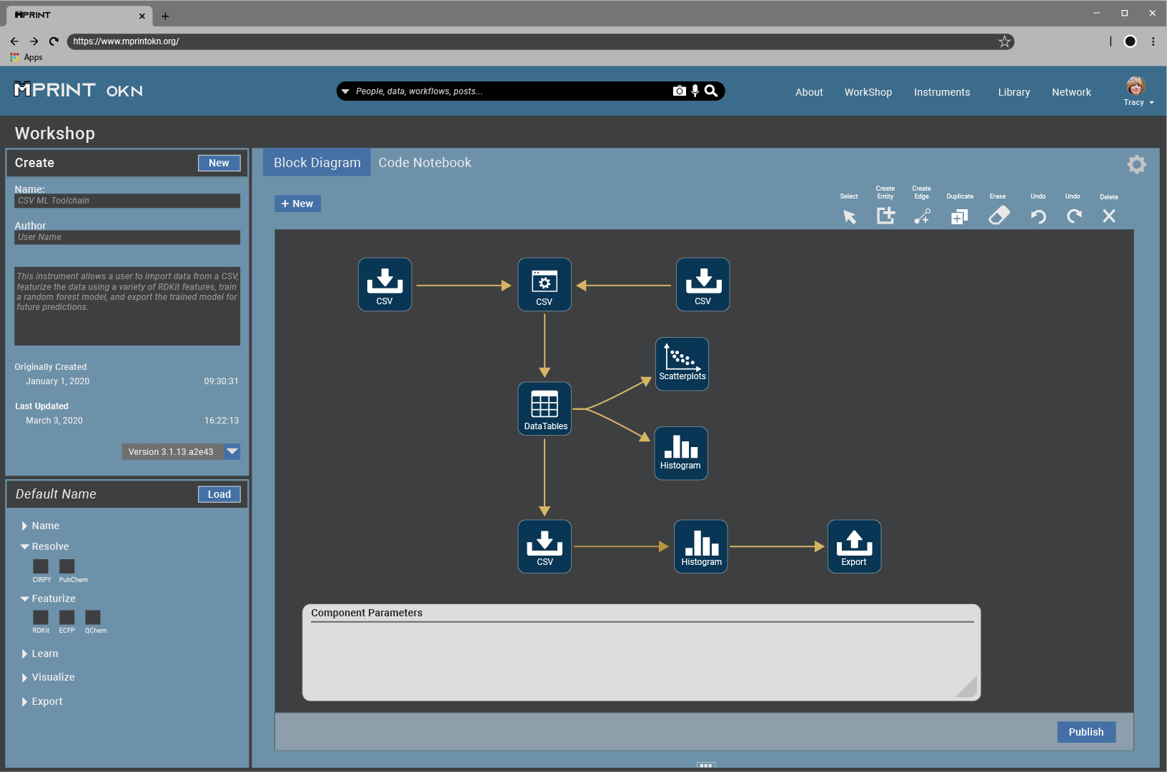
Notes:
Workshop:
We are also considering a workshop where users can create data workflows
Option of creating via block diagram user interface
CLICK “Code Notebook”
Or create instruments via interactive coding environment
CLICK Bottom right corner to exit.

Slide 8
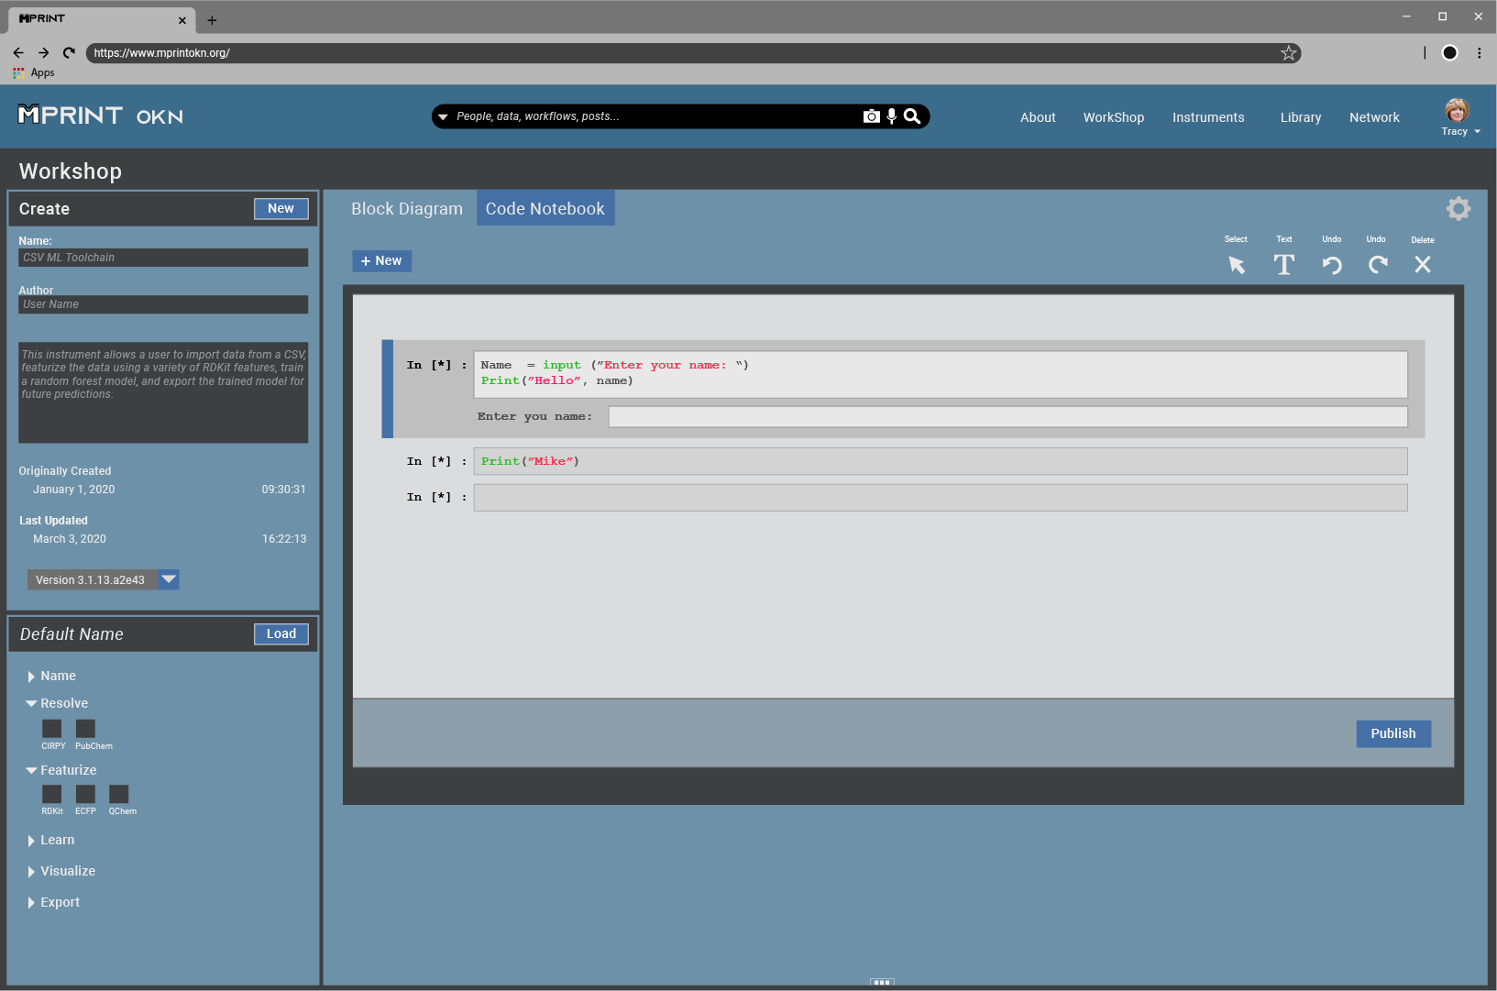
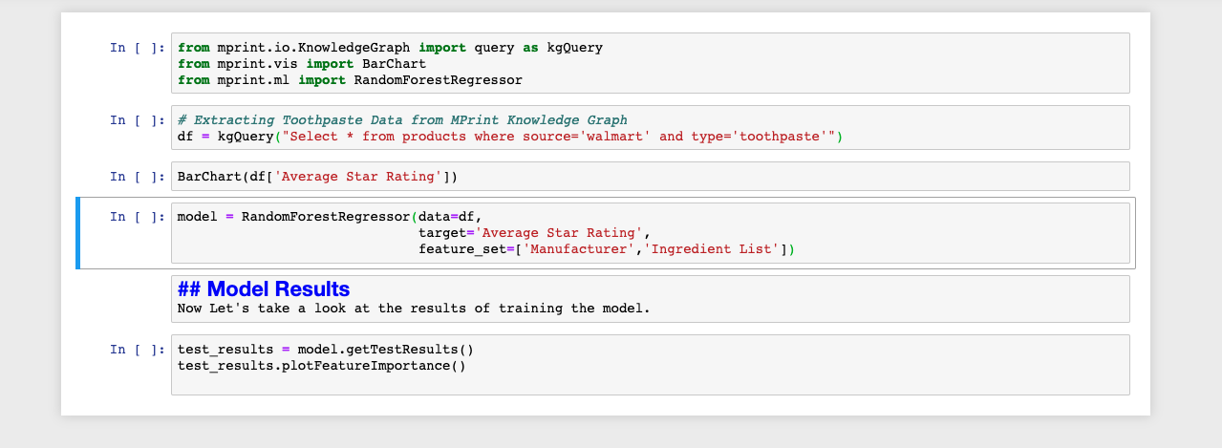
Notes:
Or create instruments via interactive coding environment
CLICK Bottom right corner to exit.

Slide 9
MPRINT Platform 1.0
MPRINT OKN is a user community
Data (Library)
Data workflows (Instruments)
Workflow development (Workshop)
Network
Notes:
To summarize: Our vision is of a Network driven by the user community
The linked in of chemistry with the addition of data and instruments to leverage the data
I will now describe the Library, Instruments, and Workshop in a bit more detail.

Slide 10
MPRINT Library
Library is for data
Universal format
Public and private
Enriched with metadata
Secure
Notes:
The backbone of the platform and network is the chemical and material data, which lives in the library
When data is ingested into the platform it will be universally formatted
Data brought on to the platform is enriched with contextual meta data enabling powerful search, tagging and mentioning features, and recommender systems.
And can be partitioned as Public or Private.
Public data will house government data sources such as National Labs, NIST, and NASA.
Private data will be populated from a variety of sources
Subscription based resources (handbook and journals) will be available based on organizational access rights.
In house measurements
Users can control the level of sharing of their data
whether that is organization wide,
specific to a user group
totally private.
All data on the platform will be safely secured using top protocols employed by federal agencies.

Slide 11

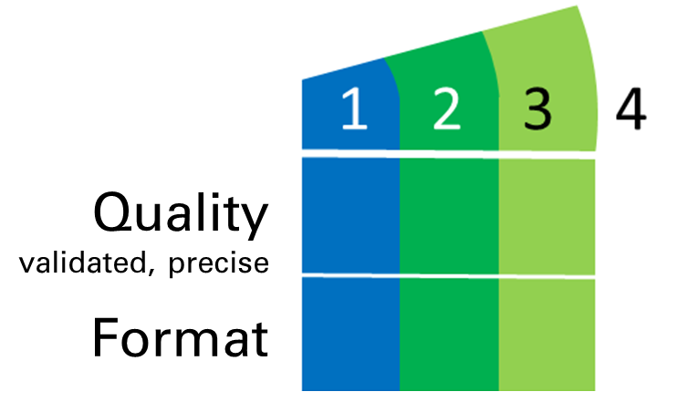

Chemical and materials data
?
Adam
https://www.gstatic.com/tv/thumb/v22vodart/4161/p4161_v_v8_aq.jpg
Notes:
Because is data is the backbone of the Network, I want to talk to you about types of data sources
There is good data, bad data and ugly data and there is the wild west of data.
Review some of the challenges associated with each source so we can discuss which types of data sources you are interested in investing in.

Slide 12

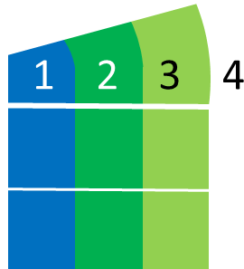

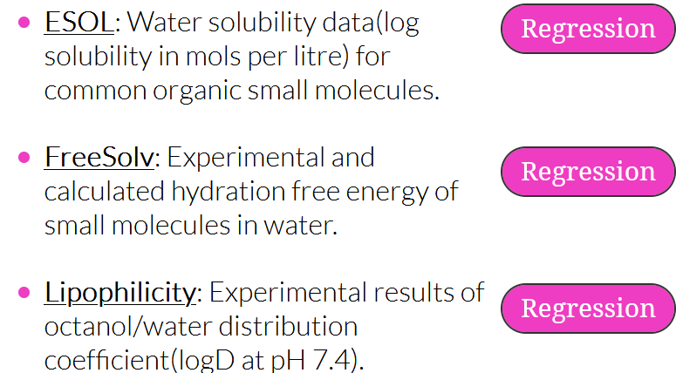
Data: the good, bad and ugly
Example: MoleculeNet.ai Lipophilicity
Quality
validated, precise
Format
Notes:
First category of data sources is where the data is curated – ensuring the data is accurate and precise.
Quality of data is high.
It is also formatted in such a way that it is amenable to digital ingestion. Things like CSV, JSON, txt.
These data sets are relatively rare, certainly free ones. One place to find such data sets is
MoleculeNet.ai which hosts a series of benchmark datasets used in molecular machine learning exercises

Slide 13

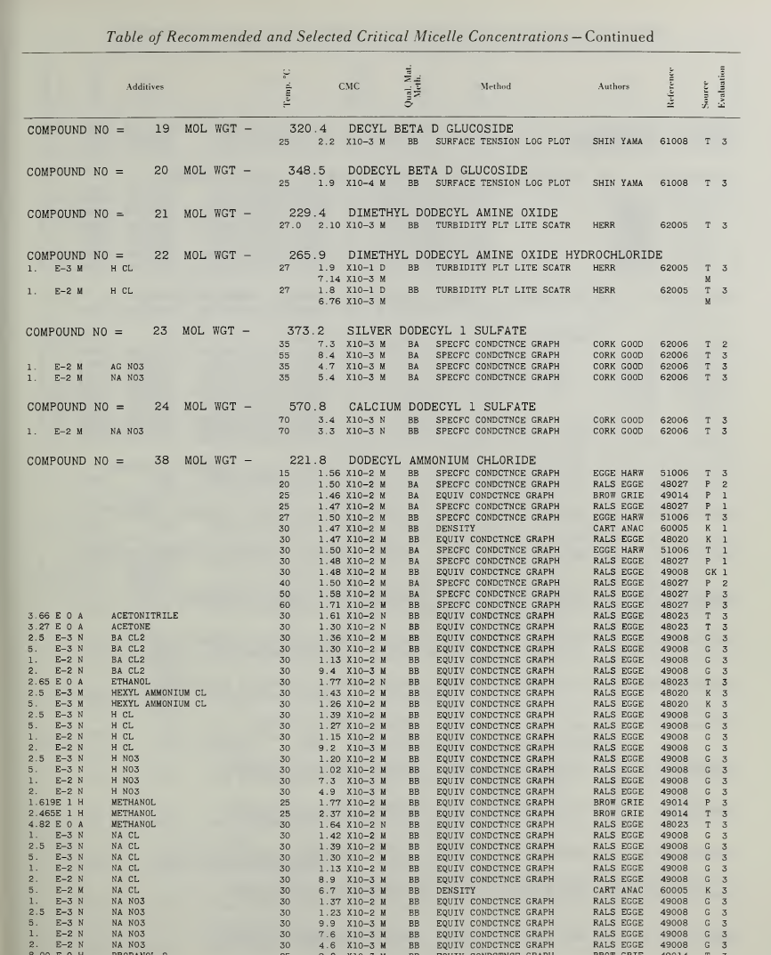
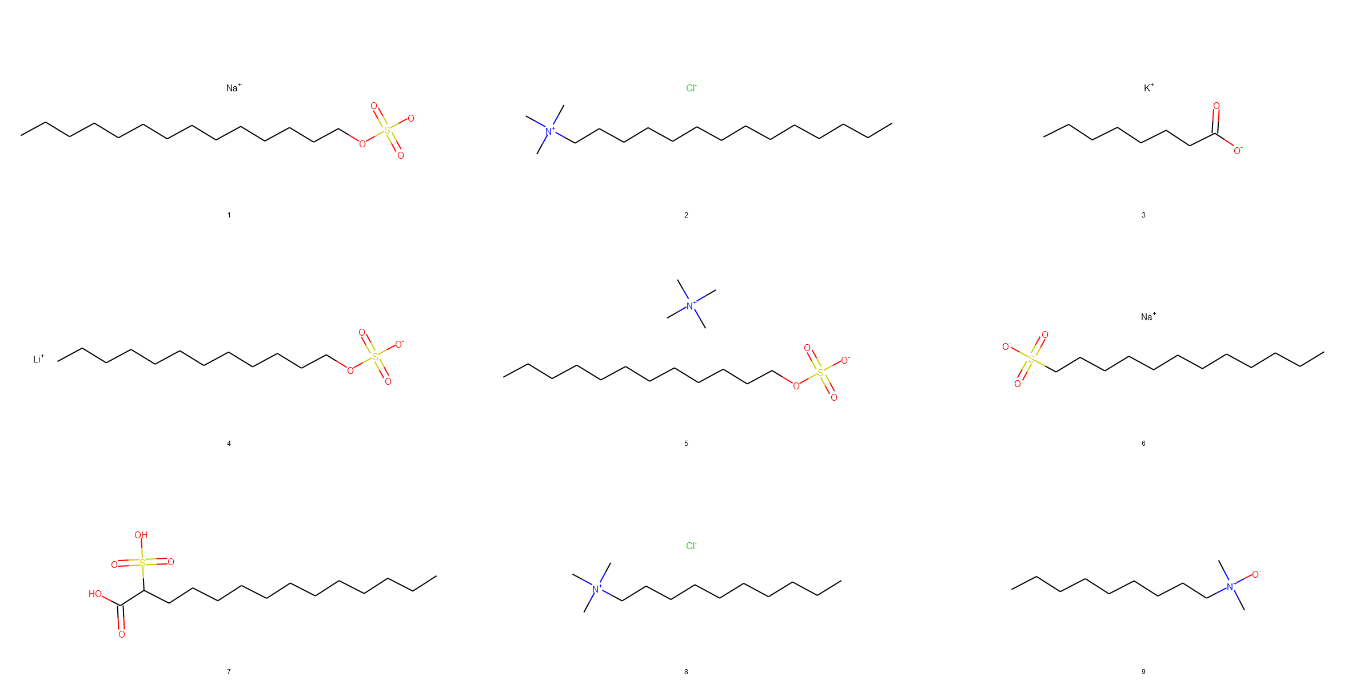
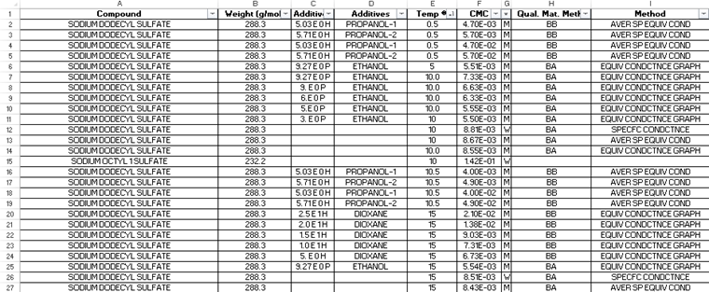
Data: the good, bad and ugly
Example: NIST CMCs of Aqueous Surfactant Systems
Quality
validated, precise
Format
Notes:
The second type of source has high quality data but challenging format.
Many of you have expressed interest in National Lab data, an example of which is the NIST handbook of critical micelle concentrations.
It is a scanned images of the book, which was published by NIST in 1971
Its format is human readable, but not easily machine ingested.
One such challenge is the large, irregular gaps and un-even column spacing
We have developed an ingestor for this handbook, that extracts the data from the book, but it is not generalizable to other resources.

Slide 14
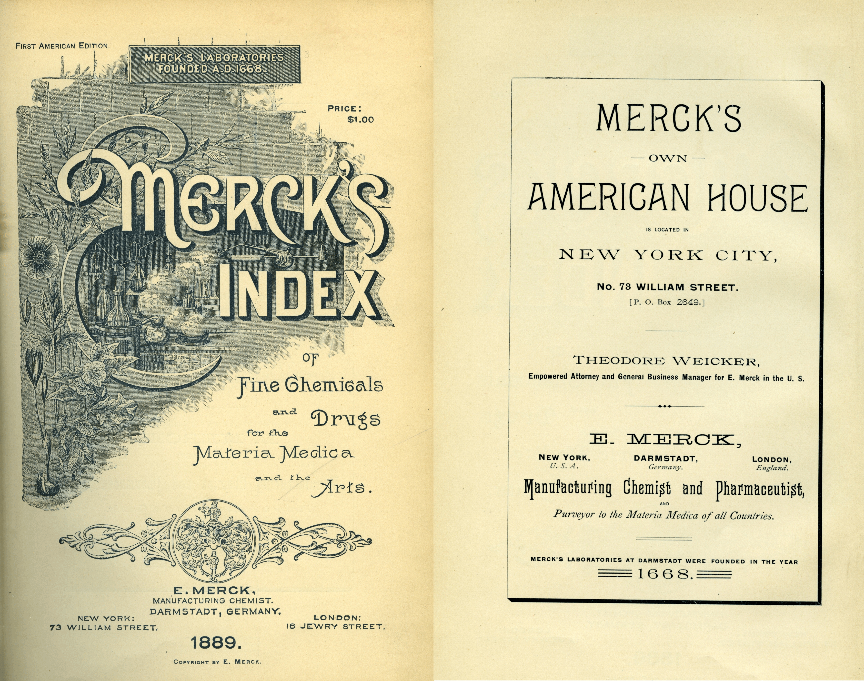

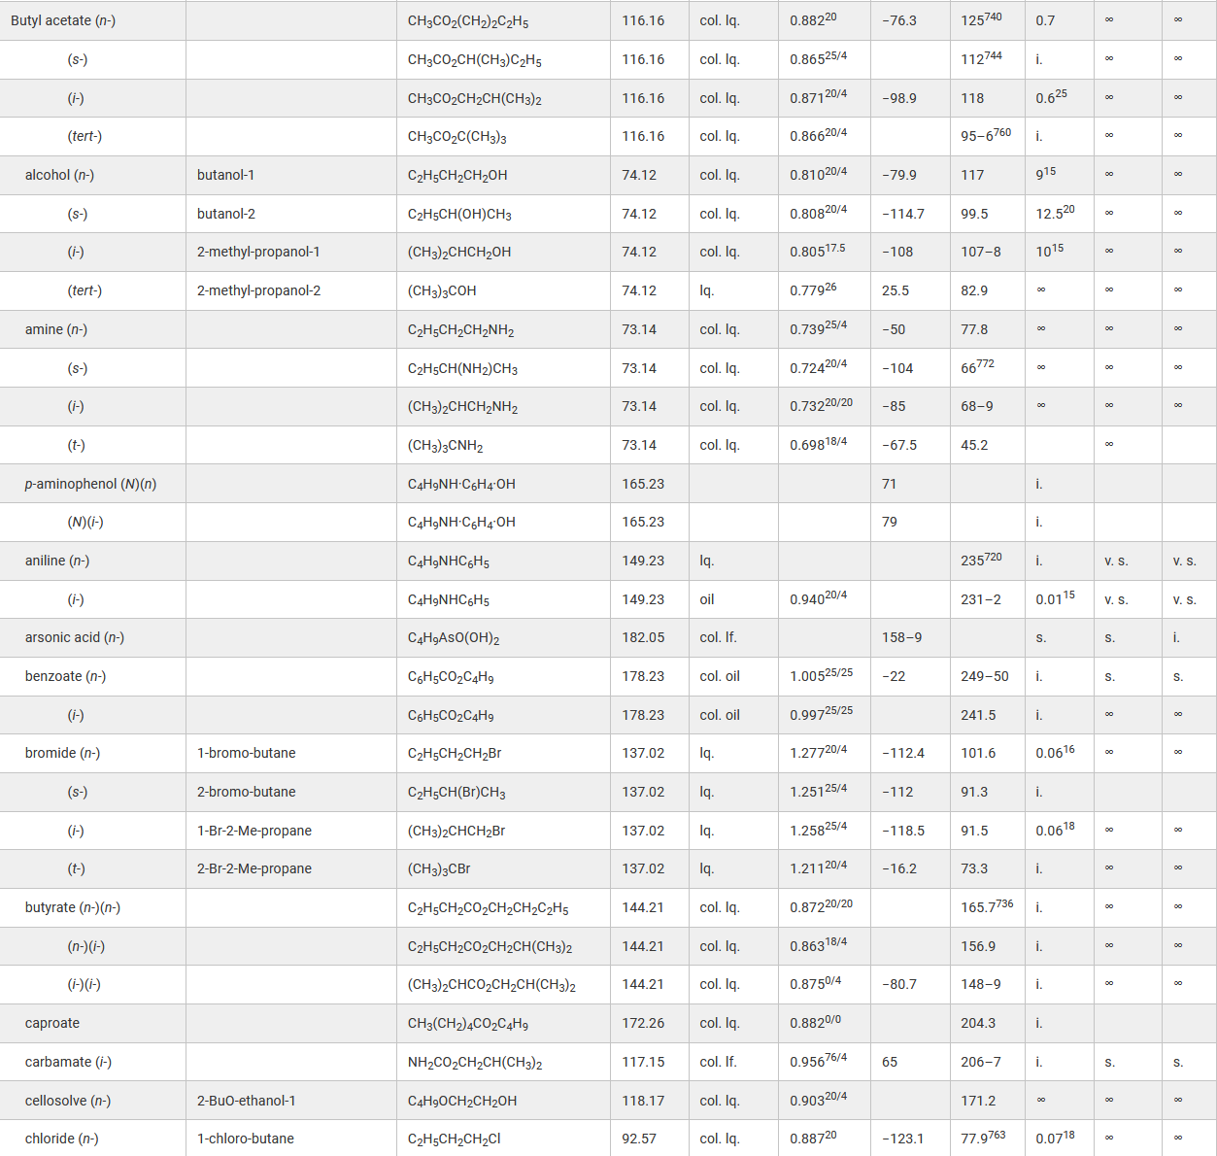
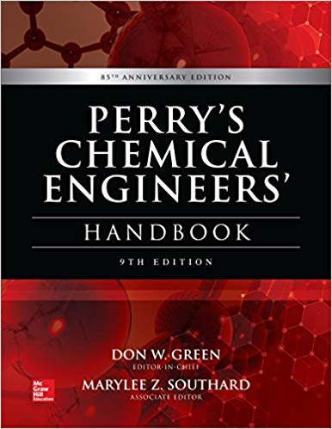


Data: the good, bad and ugly
Notes:
There are many handbooks in chemistry and chemical engineering (Merck, CRC, Langes and Perry’s)
Each resource present their information in a different format
On the right is a table 2.2 of physical properties of organic compounds found in Perry’s chemical engineering handbook 9th edition.
In this edition, the publisher made many of the tables in a digital friendly format, but the original indexing system used to make the table proves to be the challenge.
In order to unambiguously identify a chemical substance, it requires the understanding of 3 columns and many preceding rows. (Walk through specific example as fast as possible) (Butyl benzoate)
The take home message of this is that resources such as handbooks can be ingested but require some investment on a per resource basis.
We would like your feedback about which, if any, of these types of resources are of interest to you.
Again, we want to align our priorities to create a minimum viable user segment.

Slide 15

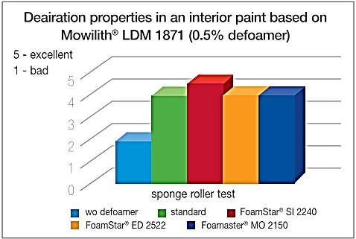
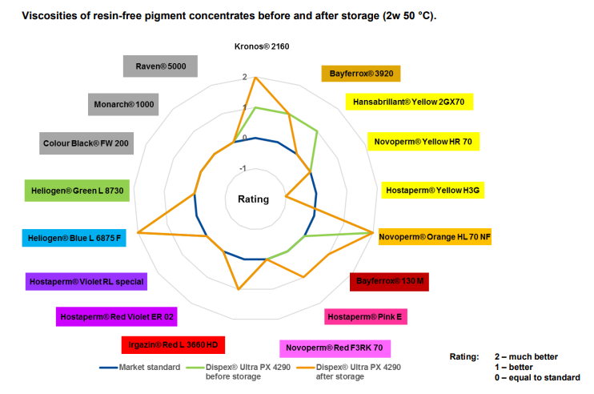
Data: the good, bad and ugly
Example: Manufacturer Technical Datasheets
Quality
validated, precise
?
Format
Useful data – truly performance
Difficult to quantify precisely
Notes:
This is useful data that you, the manufacturers have, about the performance of your products.
Some of it is qualitative
Some is quantitative
It comes in various formats and various scales (4 on one scale not equal to 4 on a different scale)

Slide 16
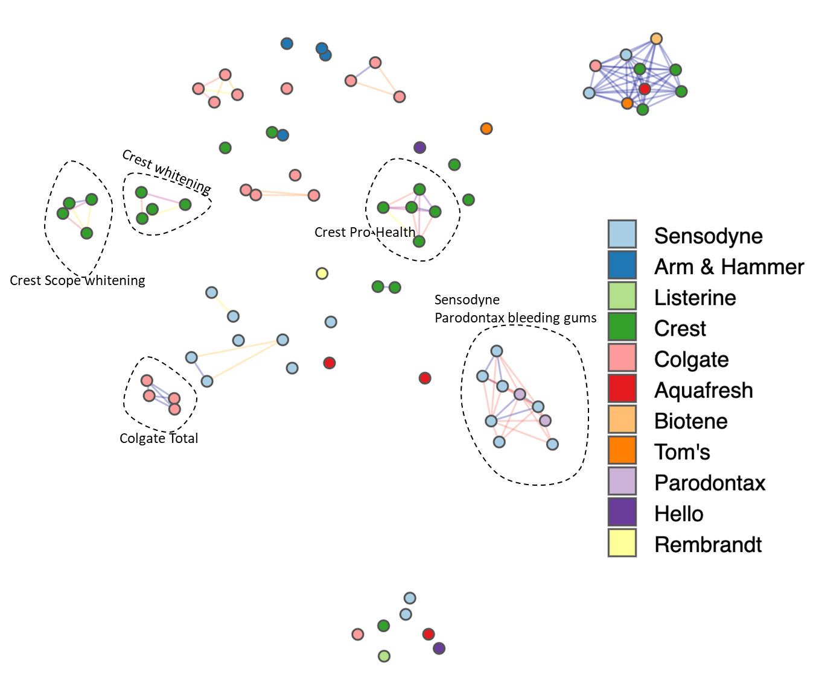
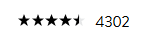
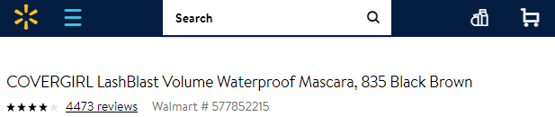
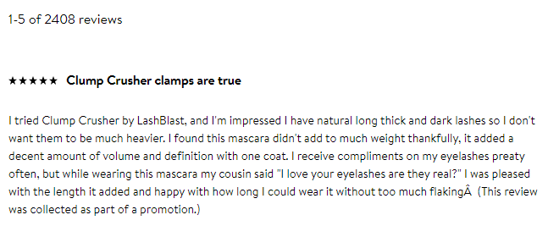
Data: the good, bad and ugly
Example: Consumer product feedback from digital marketplace
Quality
validated, precise
Format
Notes:
Then there is the Wild West of data: consumer product feedback from the digital marketplace
It is like San Fransico during the gold rush
There were no rules or law
You have to work hard at digging and sifting through the muk while avoiding dangerous pit falls
You are likely to find gold (in this case, consumer perception insights)
Highly heterogeneous formatting, not validated, error prone
We have developed instruments to collect, process and analyze this type of data from Walmart’s website.
Resources such as smart-lable.org greatly help resolve what ingredients are in a product, we still have the challenge of the consumer reviews.
Like handbooks, instruments that collect consumer reviews are not generalizable.
An Instrument that collects product reviews from Walmart’s website will not work on Amazon’s specific format
Because of this, we would like to get your feedback on which web resources are valuable to you

Slide 17

MPRINT Instruments
Instruments are data Apps
Robust, validated workflows
Simple: import, visualize, featurize
Complex – “End-to-end”
Customizeable
Notes:
Instruments are data Apps
They are robust, validated workflows that are comprised of a series of data unit operations.
Instruments can be simple: Import a dataset and visualize it
Or they can be complex, fully end-to-end processes involving many operations
Instruments can be customized by the user to meet specific needs in the workshop

Slide 18
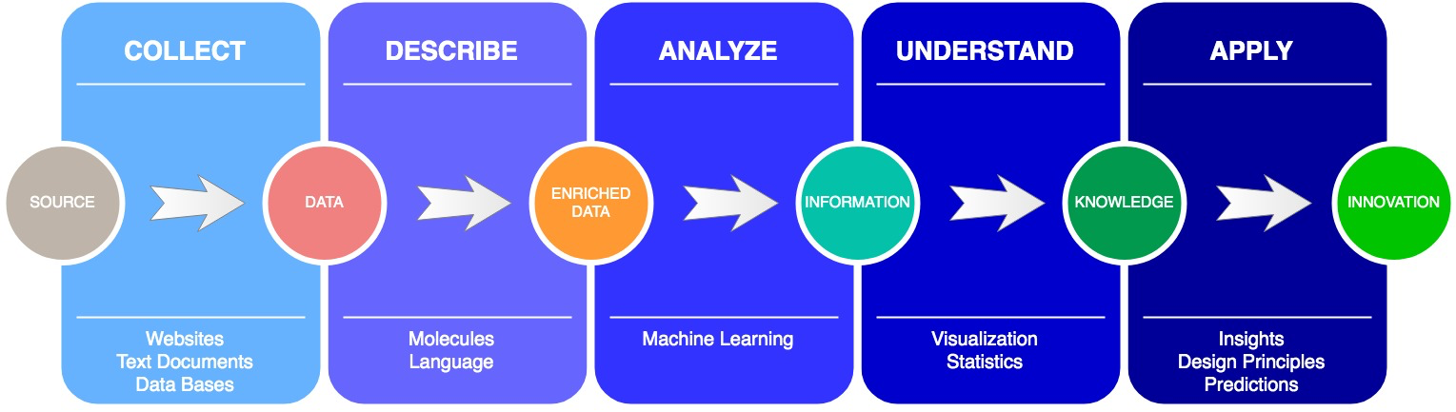
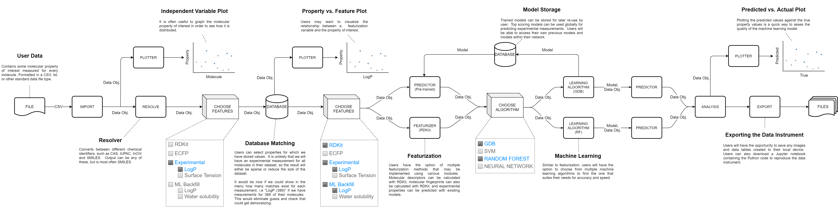
MPRINT Instruments
Notes:
The top graphic is our overarching vision of an instrument workflow
Collect data from a source (web, local file, or platform database)
Describe that data with meta-data and featurizations
Analyze the enriched data to extract information
Understand the information by means of visuals and statistics
Apply your knowledge to accelerate your innovation
Below is specific end-to-end Instrument workflow we have developed
That ingests users data and cross checks it with the platform database
Provides the option to plot and featurize their chemical data
Use the data for machine learning regression
Export their results and the underlying code of the instrument.
Seth Henshaw is going to present a live demonstration of a similar instrument that has been truncated for the sake of time

Slide 19
Notes:
Seth does live demo from web browswer. 5 mins

Slide 20
MPRINT Workshop
Workshop is development space
Sandbox for customizing workflow
Import from tool library
GUI or code-based input
Publish tagged with metadata
Extensible
Notes:
That was a demonstration an instrument that can regress a dependent variable with a number of independent variables.
We understand that this instrument will not meet every need.
There are two paths to the creation of Instruments: hire engineers to create them, or enable users to create their own instruments.
We have a contemplated a workshop where users can develop and customize data instruments
Existing instruments can be used as templates and edited either by GUI or interactive coding environment.
Users have the option to publish completed instruments, along with descriptions and meta data
The workshop is an extensible solution by providing users the opportunity to create Instruments that meet their needs
This concludes our demonstration of a minimum viable product. Again, we are focused on recruiting your organizations as part of the minimum viable segment.
In order to do this, we need to discuss priority activities.

Slide 21

Discussion of next steps
Tools
People
Platform
Web Scrapers
Document Ingest
Visualizations
Machine Learning
Featurization
PhD Interns
Undergrad Interns
Tutorials/Videos
Training
Data Storage/Security
Knowledge Graphs
Messaging
Tool Workshop
User load capacity

